Slide 1









PinkyWinky
Julien, Guillaume, Angelica, Jean-Baptiste, Gabriel, Shrey
Feat. Hélène

Slide 2


Agenda
Team organization
Design vs results
Challenges
Demo
Key takeaways

Slide 3

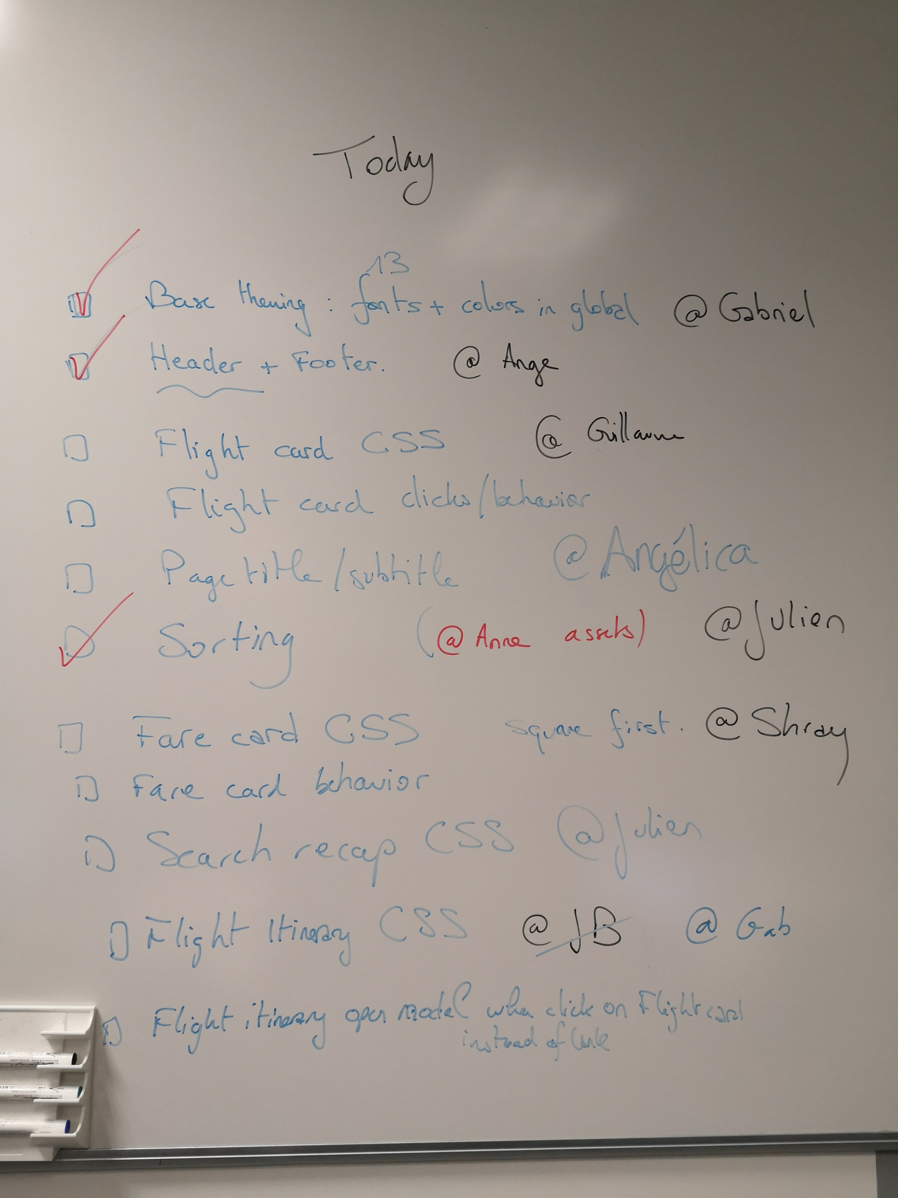
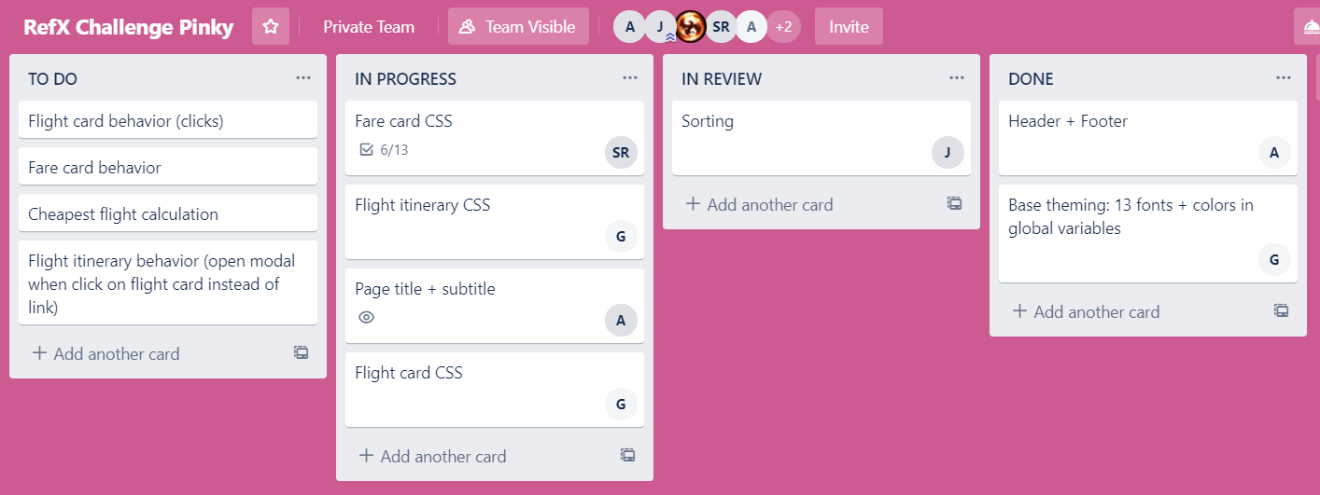
Team organisation
Talked together about the UI components in Zeplin
Wrote them down on the white board and in Trello
Each person assigned a task to himself/herself proactively

Slide 4
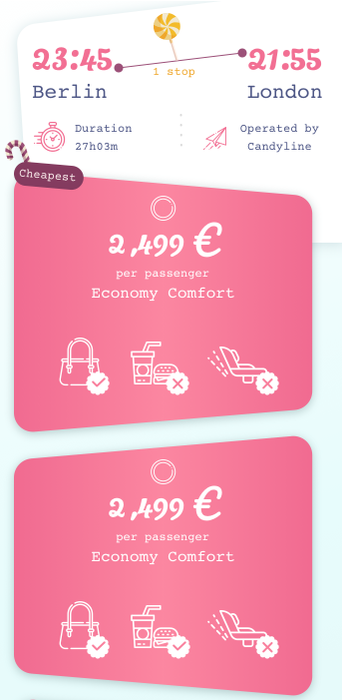
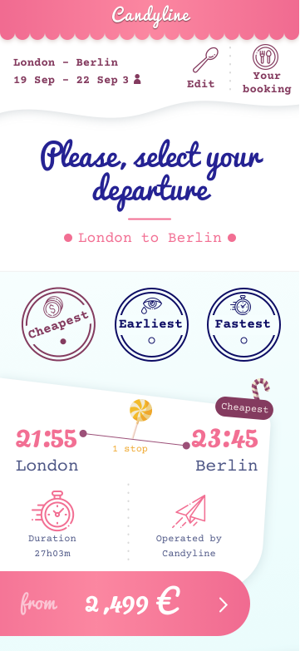
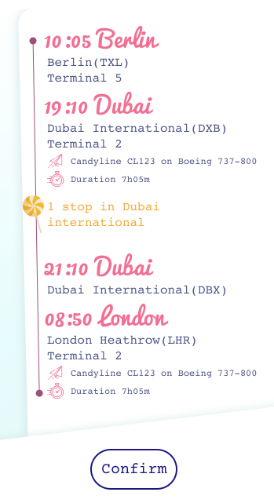
Design chosen vs Results preview

Slide 5
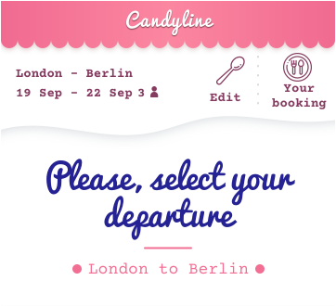
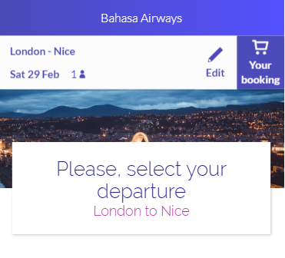



Page top
Expected
Reality
Config
CSS variables
CSS override

Slide 6
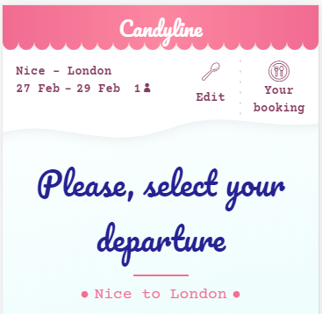
Page top
Expected
Reality
Config
CSS variables
CSS override

Slide 7


Sorting
Expected
Reality
Config
CSS variables
CSS override

Slide 8
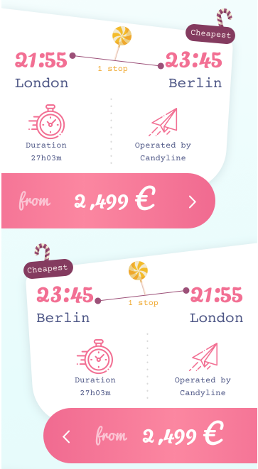
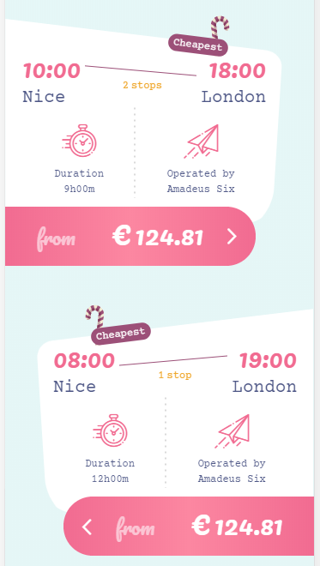
Flight cards
Expected
Reality
Config
CSS variables
CSS override
Code change

Slide 9
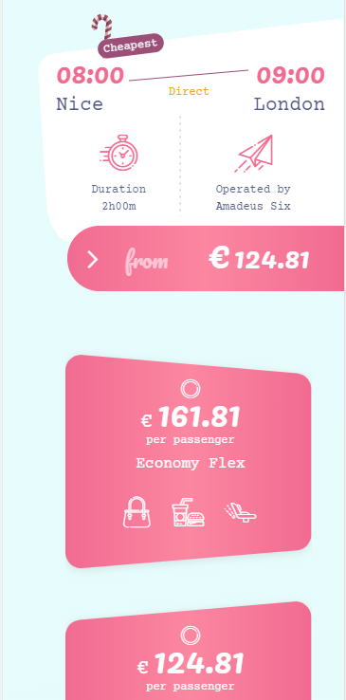
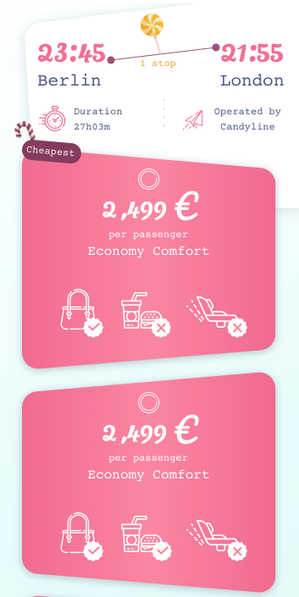
Fare cards
Reality
Expected
Config
CSS variables
CSS override

Slide 10
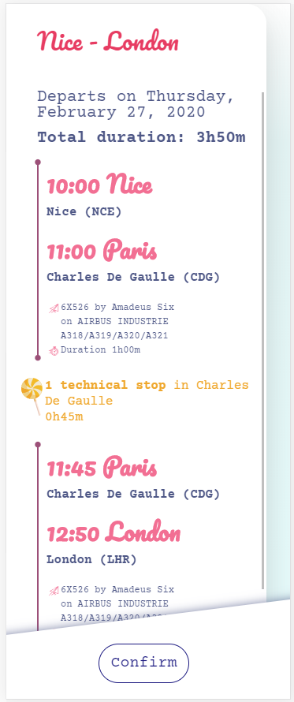
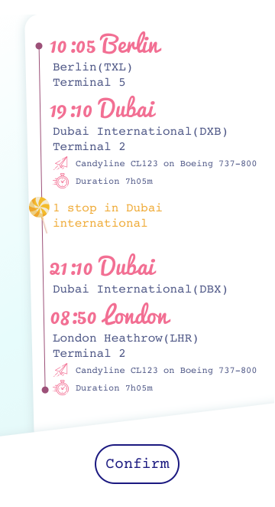
Itinerary details
Reality
Expected
Config
CSS variables
CSS override
Config
CSS variables
CSS override

Slide 11
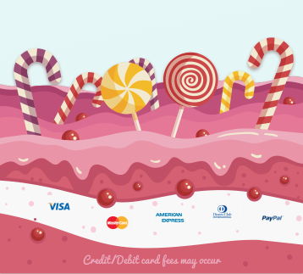
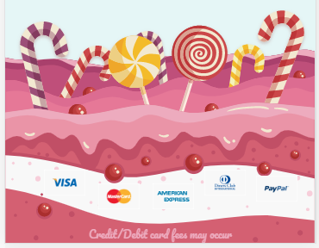
Page bottom
Expected
Reality
Config
CSS variables
CSS override

Slide 12
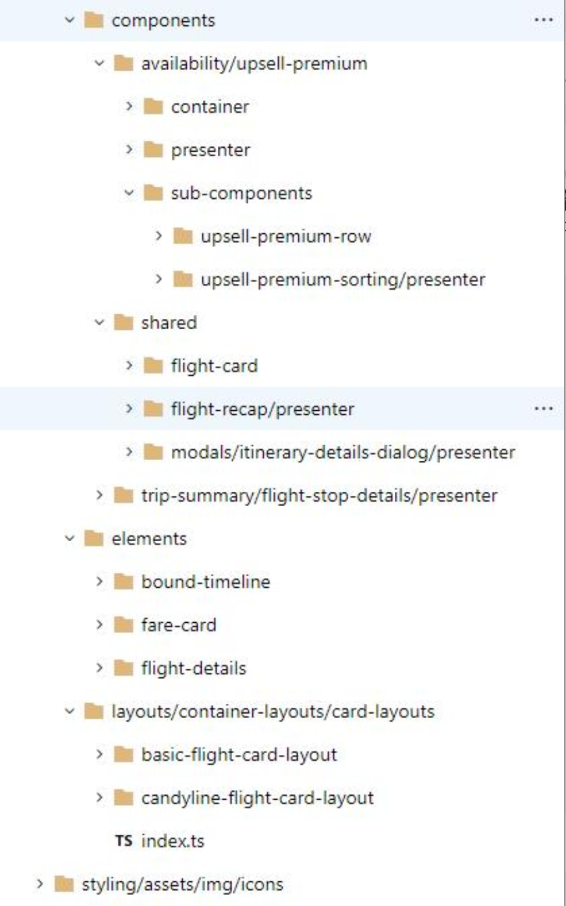
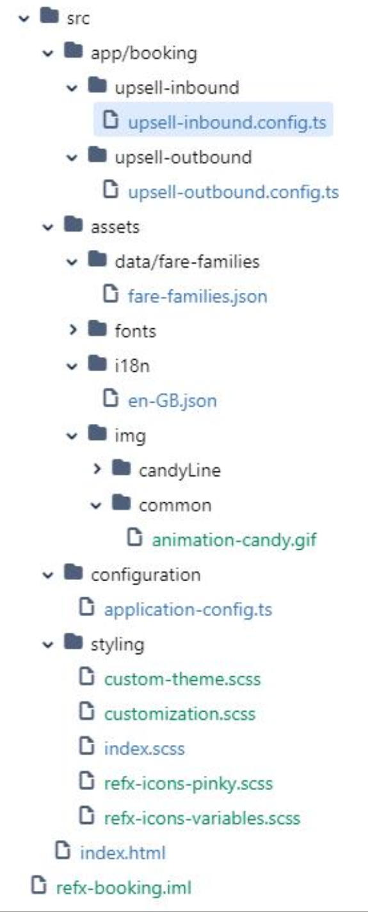
Customization impacts
RefX lib: 350+ lines changed
Booking app: 1900+ lines changed

Slide 13
Challenges (1/2)
Lost a team member on the first day ☹ (sick)
Remote team with our BLR teammate
Another team member did not have the rights to access the refx-lib
Almost all morning lost
Different levels of skills for RefX

Slide 14
Challenges (2/2)
Changes in interaction design
In the shoes of implementation guy
“Cheapest flight” feature has to be developed
Some bugs found in the library (configuration)
Palette and typography not provided

Slide 15
Demo time

Slide 16

Key takeaways
Interaction design cannot be easily customized
We proved RefX capabilities
Improved RefX knowledge

Slide 17


Thank you

Slide 18

RefX components used
Config
CSS variables
CSS override
Flight card
Config
CSS variables
CSS override
Itinerary details
Config
CSS variables
CSS override
Header and footer
Config
CSS variables
CSS override
Fare card
Config
CSS variables
CSS override

Slide 19
Page title
Text

Slide 20
Page title
Text

